Slide 1
Capital Structure and Leverage
Capital structure and financial structure;
Determining the optimal capital structure:
EBIT−EPS analysis of the effect of financial leverage,
EPS indifference analysis;
The effect of capital structure on stock prices and the cost of capital;
Capital structure and value of the firm;
Operating Leverage, Financial Leverage and Total Leverage

Slide 2
Capital Structure and Financial Structure
Capital Structure
Mix of permanent and long term financing
Permanent Financing of the firm represented primarily by long term debt and equity
Capital Structure = Long-term Debt + Preferred Stock + Common Equity
Optimum capital structure is the combination of proportions that maximize the total value of the firm and minimize cost of capital
Financial Structure
Wider than capital structure; refers to the structure of total finance
Composition of short term debt, long term debt and equity
Consists of all items of the liabilities and equity side of B/S
Optimum financial structure the set of proportions that maximizes the total value of the firm and maximize market price

Slide 3
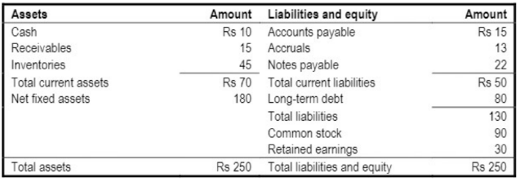
Capital Structure and Financial Structure
Forms of Capital Structure
Equity shares only
Equity and Preference shares only
Equity and long term debt only
Equity shares, preference shares and long term debt

Slide 4
Determining the Optimal Capital Structure
Optimum capital structure is not necessary the one that maximizes the EPS, but the one that maximizes stock price
Cost of capital is minimized, value of the firm is maximized
Is the one that maximizes the price of the firm’s stock and this generally calls for a debt ratio that is lower than the one that maximizes expected EPS
WACC and Capital Structure:
WACC = W_{d} K_{dt} + W_{ps} K_{ps} + W_{e} K_{e}
If no Preferred stock in firms capital structure then
WACC = W_{d} K_{dt} + W_{e} K_{e}
= (D/A) K_{dt} + (E/A) K_{e}
Where D/A is debt assets ratio and E/A is equity assets ratio. They sum to 1.

Slide 5
EBIT−EPS analysis of the effect of financial leverage
Financial leverage results when fluctuation in earnings before interest and taxes (EBIT) is accompanied by disproportionate fluctuation in the firm’s earning per share (EPS)
Shows the responsiveness of company’s EPS to change in the EBIT
Example Problem: The management of a new firm is expecting on EBIT for a period is Rs 10,000. It is considering following three alternative financial plans:
Financial Plan A: Issuing 5,000 common shares of Rs 10 per share
Financial Plan B: Issuing 2,500 common shares of Rs 10 per share, Rs 25,000 in debt at 12% rate of interest
Financial Plan C: Issuing 1,500 common shares of Rs 10 per share. Issuing 1,000; 13% preference shares of Rs 10 per share; Rs 25,000 in debt at 12% rate of interest.
Tax rate is 50%
Required: EPS in each of the alternative plans of financing.

Slide 6
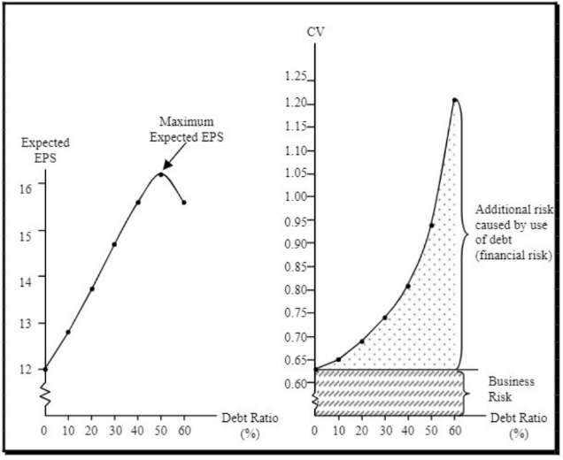
EBIT−EPS analysis of the effect of financial leverage
Highlight on the example of the Asmita Publication (page no 212 to 214) then focus on below figure

Slide 7
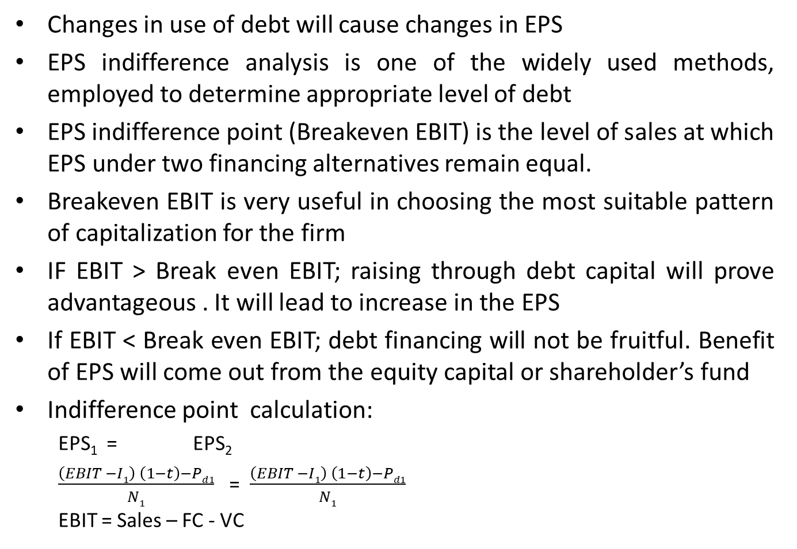
EPS Indifference Analysis
Changes in use of debt will cause changes in EPS
EPS indifference analysis is one of the widely used methods, employed to determine appropriate level of debt
EPS indifference point (Breakeven EBIT) is the level of sales at which EPS under two financing alternatives remain equal.
Breakeven EBIT is very useful in choosing the most suitable pattern of capitalization for the firm
IF EBIT > Break even EBIT; raising through debt capital will prove advantageous . It will lead to increase in the EPS
If EBIT < Break even EBIT; debt financing will not be fruitful. Benefit of EPS will come out from the equity capital or shareholder’s fund
Indifference point calculation:
EPS₁ = EPS₂
$\frac{\left(EBIT −I1\right) \left(1−t\right)−Pd1}{N1}$ = $\frac{\left(EBIT −I1\right) \left(1−t\right)−Pd1}{N1}$
EBIT = Sales – FC - VC

Slide 8
EPS Indifference Analysis
The following two financial plans are proposed:
Determine the indifference point of the financial plan
Earning per share at indifference Point
 | Financial Plan 1 | Financial Plan 2
Equity Shares of Rs. 100 each | Rs 1,500,000 | Rs. 1,000,000
10% Debenture of Rs 100 each |  | Rs 500,000
Tax rate = 50%

Slide 9
The Effect of Capital Structure on Stock Prices and Cost of Capital
Optimal capital structure maximizes the firm’s stock price and minimizes cost of capital
WACC is minimum when the stock price is maximum
Stock prices are positively related to expected dividends but negatively related to the required return on equity
Firms with higher earning are able to pay higher dividends so to the extent that higher debt levels raise expected EPS, leverage works to increase the stock price
Financial manager should chooses the capital structure that maximizes shareholders wealth and the firm’s stock price, and minimizes the firm’s cost of capital

Slide 10
Example Problem
A company currently has assets of Rs 5 million. The firm is 100 percent equity financed. The company currently has net income of Rs 1 million and it pays out 40 percent of its net income as dividends. Both net income and dividends are expected to grow at a constant rate of 5 percent per year. There are 200,000 shares of stock outstanding, and it is estimated that the current cost of capital is 13.40 percent.
The company is considering a recapitalization where it will issue Rs 1 million in debt and use the proceeds to repurchase stock. Investment bankers have estimated that if the company goes through with the recapitalization, its before-tax cost of debt will be 11 percent, and the cost of equity will rise to 14.5 percent. The company has a 40 percent federal plus state tax rate.
What is the current share price of the stock (before recapitalization)
Assuming that the company maintains the same payout ratio, what will be its stock price following the recapitalization ?

Slide 11
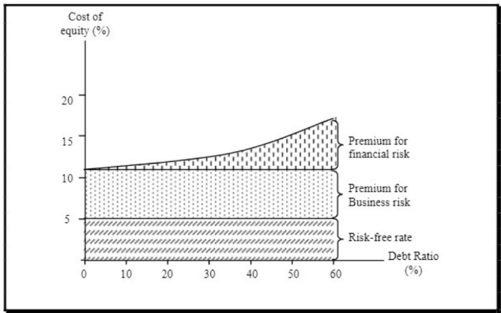
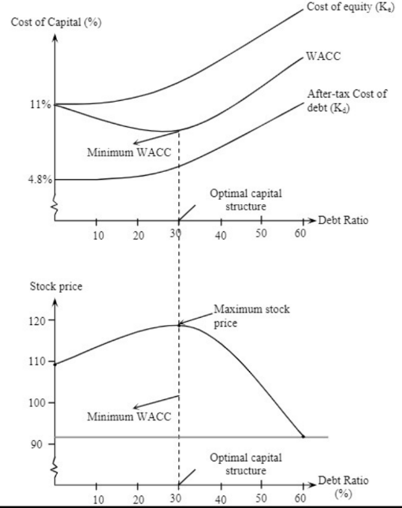
Example Figure

Slide 12

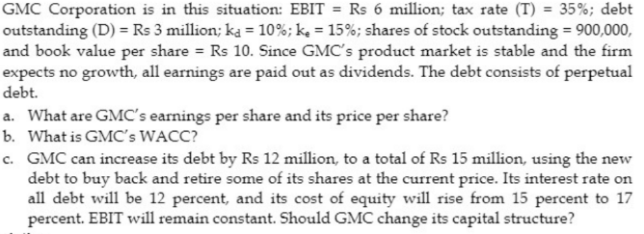
Example Problem
Leverage Beta β_{L} = β_{U} [1+(1-T)(D/E)]
K_{e} = R_{F} + [E(R_{m}) – R_{F} ]β
1.
2.

Slide 13
Capital Structure and Value of Firm
At optimal capital structure cost of capital is the minimum and stock price is the maximum.
Two conflicting arguments on relationship between firm’s cost of capital and value of the firm
Irrelevance Approach
Modigliani and Miller (MM) argue that in a perfect market, market value of any firm is independent of its capital structure
They argue that total value of a firm depends on its underlying profitability and risk, and not as how the firm is finance
Irrelevance proposition of MM states that two firms alike in every respect except their capital structure must command the same total value
If not, profit seeking investors tend to sell shares of overvalued firm and buy the shares of undervalued firm thereby enforcing two firms into equilibrium

Slide 14
Capital Structure and Value of Firm
2. Relevance Approach
Imperfections in the capital market makes capital structure relevant in affecting the cost of capital and the value of firm
One imperfection is due to effect of taxes (interest payment on debt is allowable deductions for tax purpose)
Corporate tax does matter because value of a levered firm is greater than the unlevered firm by the amount of present value of tax saving on debt
Other imperfections that distorts the benefits of using debt capital beyond certain limit ( firm may risk some sort of financial distress or bankruptcy when timely interest payment is not made)
Therefore optimum capital structure assumes that a firm balances the marginal present value of interest tax saving against the cost of financial distress.

Slide 15
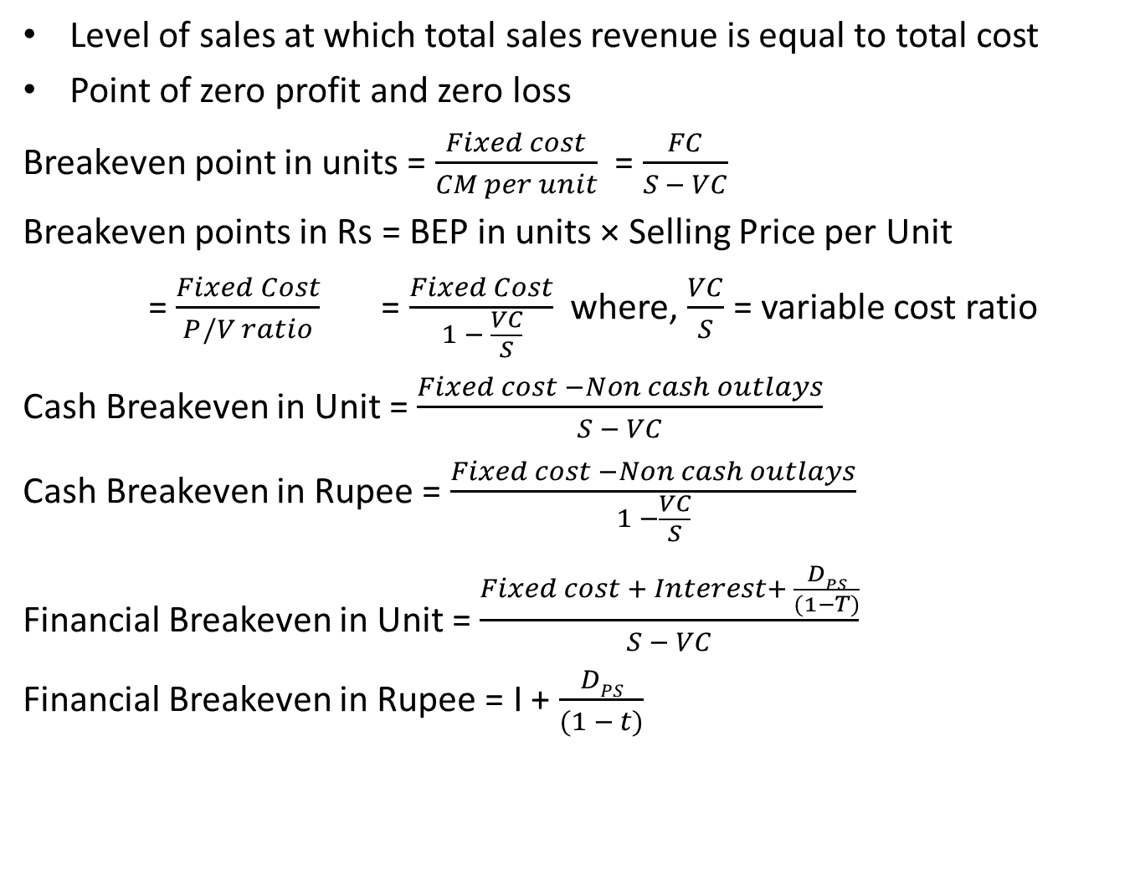
Breakeven Analysis
Level of sales at which total sales revenue is equal to total cost
Point of zero profit and zero loss
Breakeven point in units = $\frac{Fixed cost}{CM per unit}$ = $\frac{FC}{S − VC}$
Breakeven points in Rs = BEP in units × Selling Price per Unit
= $\frac{Fixed Cost}{P/V ratio}$ = $\frac{Fixed Cost}{1 − \frac{VC}{S}}$ where, $\frac{VC}{S}$ = variable cost ratio
Cash Breakeven in Unit = $\frac{Fixed cost −Non cash outlays}{S − VC}$
Cash Breakeven in Rupee = $\frac{Fixed cost −Non cash outlays}{1 −\frac{VC}{S}}$
Financial Breakeven in Unit = $\frac{Fixed cost + Interest+ \frac{DPS}{(1−T)}}{S − VC}$
Financial Breakeven in Rupee = I + $\frac{DPS}{(1 − t)}$

Slide 16
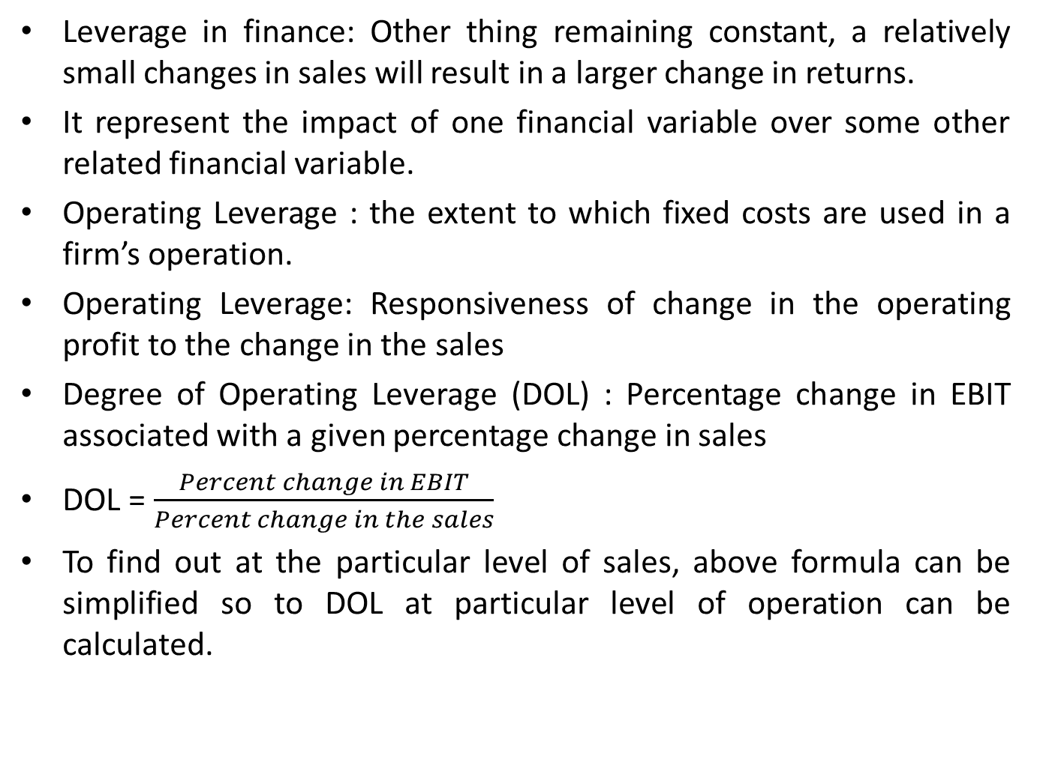
Operating Leverage
Leverage in finance: Other thing remaining constant, a relatively small changes in sales will result in a larger change in returns.
It represent the impact of one financial variable over some other related financial variable.
Operating Leverage : the extent to which fixed costs are used in a firm’s operation.
Operating Leverage: Responsiveness of change in the operating profit to the change in the sales
Degree of Operating Leverage (DOL) : Percentage change in EBIT associated with a given percentage change in sales
DOL = $\frac{Percent change in EBIT}{Percent change in the sales}$
To find out at the particular level of sales, above formula can be simplified so to DOL at particular level of operation can be calculated.

Slide 17
Degree of Operating Leverage (DOL)
DOL _{Q units} = $\frac{Contribution Margin}{EBIT}$ Or,
DOL _{Q units} = $\frac{Q (S−V)}{Q \left(S−V\right) −FC}$ Or,
DOL _{Q units} = $\frac{EBIT + FC}{EBIT}$
DOL can also be calculated by using operating break even point.
DOL _{Q units} = $\frac{Q}{Q −BEP units}$
Significance of Operating Leverage:
It tells impact of changes in sales on operating income of firm
A firm having higher DOL can dramatically increase operating profit for even a small change in sales level.
Operating leverage depends on fixed cost. If fixed costs are higher, the higher would the firms operating leverage and its operating risk
If operating leverage is high it automatically means that the breakeven point would also be reached at a higher level of sales.

Slide 18

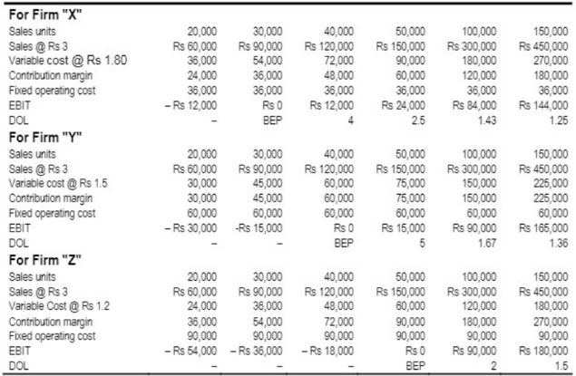
Implication:

Slide 19
Financial Risk and Financial Leverage
Financial Risk : As increase in stockholder’s risk over and above the firm’s basic business risk, resulting from the use of financial leverage.
If firm have no interest expenses or preferred dividends, it has no financial risk
Financial risk is associated with the use of debt capital. More the debt capital a firm uses, higher the financial risk.
Financial Leverage : The extent to which fixed income securities are used in a firm’s capital structure.
Operating leverage sometimes is referred to as first stage leverage and financial leverage is referred as second stage leverage.
Financial leverage explains how a given change in operating income of a firm affects its earnings per share to common stockholders
It is the responsiveness of change in firm’s EPS to the change in EBIT.

Slide 20
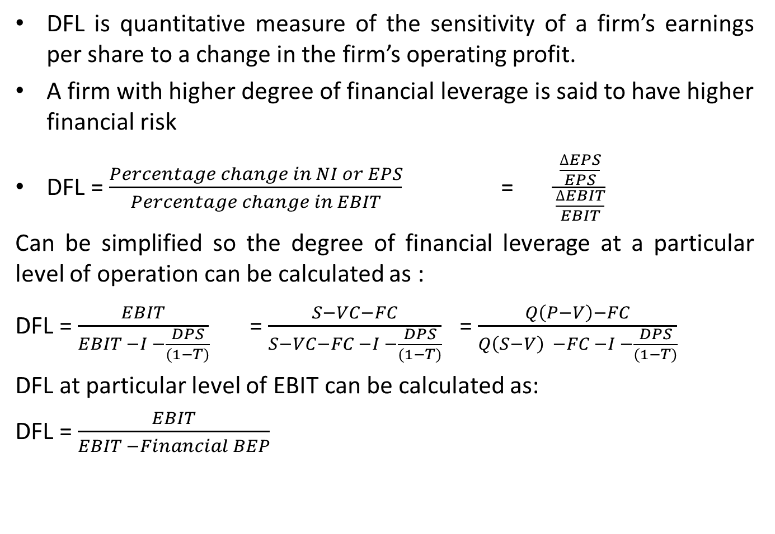
Degree of Financial Leverage (DFL)
DFL is quantitative measure of the sensitivity of a firm’s earnings per share to a change in the firm’s operating profit.
A firm with higher degree of financial leverage is said to have higher financial risk
DFL = $\frac{Percentage change in NI or EPS}{Percentage change in EBIT}$ = $\frac{\frac{∆EPS}{EPS}}{\frac{∆EBIT}{EBIT}}$
Can be simplified so the degree of financial leverage at a particular level of operation can be calculated as :
DFL = $\frac{EBIT}{EBIT −I −\frac{DPS}{(1−T)}}$ = $\frac{S−VC−FC}{S−VC−FC −I −\frac{DPS}{(1−T)}}$ = $\frac{Q\left(P−V\right)−FC}{Q\left(S−V\right) −FC −I −\frac{DPS}{(1−T)}}$
DFL at particular level of EBIT can be calculated as:
DFL = $\frac{EBIT}{EBIT −Financial BEP}$

Slide 21
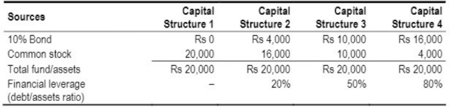
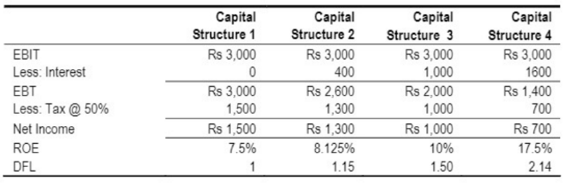
Implication of Financial Leverage

Slide 22
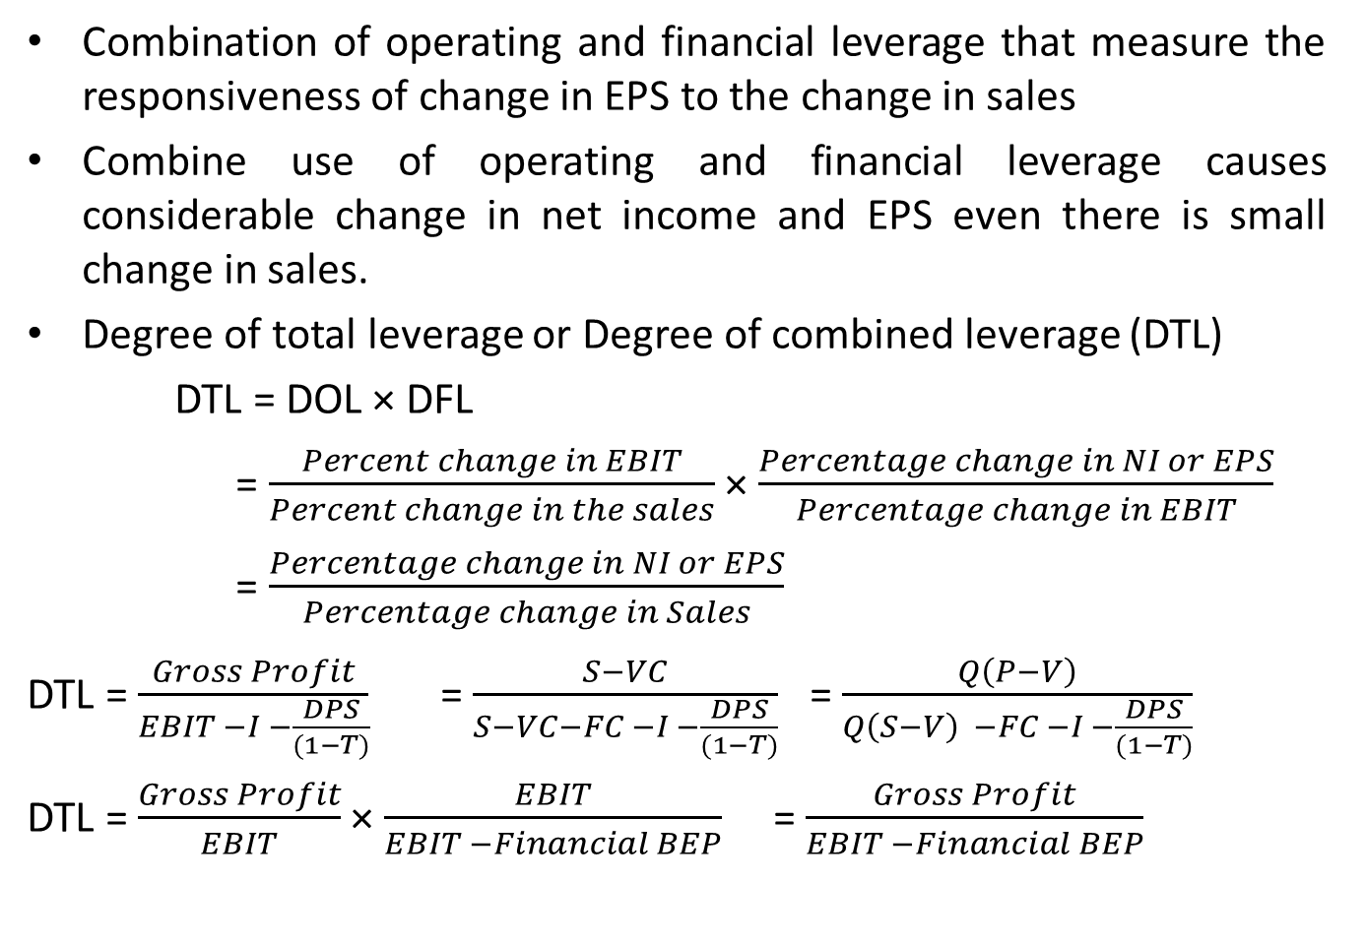
Total Leverage
Combination of operating and financial leverage that measure the responsiveness of change in EPS to the change in sales
Combine use of operating and financial leverage causes considerable change in net income and EPS even there is small change in sales.
Degree of total leverage or Degree of combined leverage (DTL)
DTL = DOL × DFL
= $\frac{Percent change in EBIT}{Percent change in the sales}$ × $\frac{Percentage change in NI or EPS}{Percentage change in EBIT}$
= $\frac{Percentage change in NI or EPS}{Percentage change in Sales}$
DTL = $\frac{Gross Profit}{EBIT −I −\frac{DPS}{(1−T)}}$ = $\frac{S−VC}{S−VC−FC −I −\frac{DPS}{(1−T)}}$ = $\frac{Q\left(P−V\right)}{Q\left(S−V\right) −FC −I −\frac{DPS}{(1−T)}}$
DTL = $\frac{Gross Profit}{EBIT}$ × $\frac{EBIT}{EBIT −Financial BEP}$ = $\frac{Gross Profit}{EBIT −Financial BEP}$

Slide 23
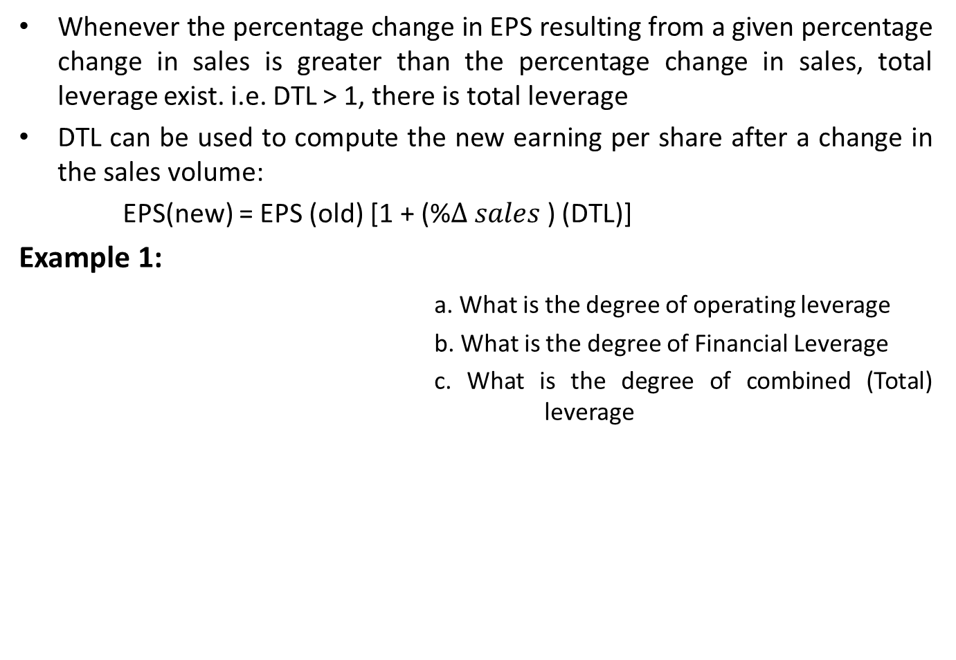
Total Leverage
Whenever the percentage change in EPS resulting from a given percentage change in sales is greater than the percentage change in sales, total leverage exist. i.e. DTL > 1, there is total leverage
DTL can be used to compute the new earning per share after a change in the sales volume:
EPS(new) = EPS (old) [1 + (%$∆ sales$) (DTL)]
Example 1:
a. What is the degree of operating leverage
b. What is the degree of Financial Leverage
c. What is the degree of combined (Total) leverage
Sales | Rs 6,400
Less: Variable Cost | 3,200
Contribution Margin | 3,200
Less: Fixed Cost | 1,600
EBIT | 1,600
Less: Interest | 600
EBT | 1,000
Less: Tax @ 50% | 500
Net Income | 500

